Slide 1
Real-time systems
Systems Refers to:
(computing, communication, and
information)

Slide 2
Where Can Real-Time Systems be Found?
RT-systems are everywhere:
• plant control
• control of production processes / industrial automation
• railway switching systems
• automotive applications
• flight control systems
• environmental acquisition and monitoring
• telecommunication systems
• robotics
• military systems
• space missions
• household appliances
• virtual / augmented reality
And many more…

Slide 3
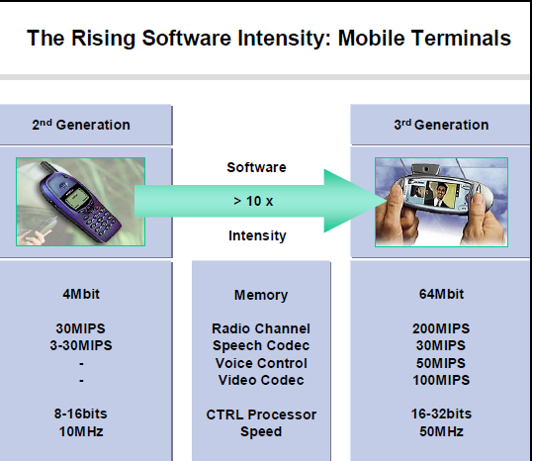

Slide 4
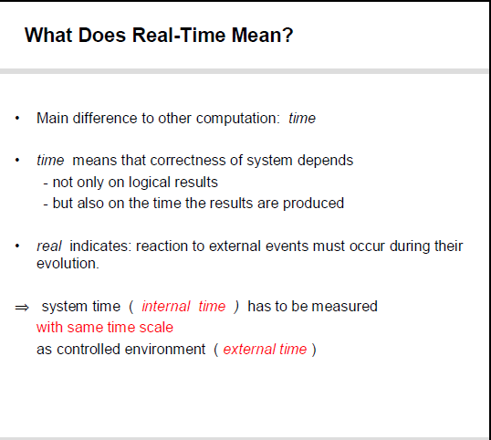

Slide 5
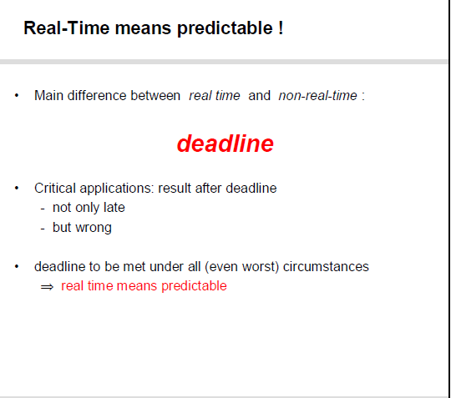

Slide 6
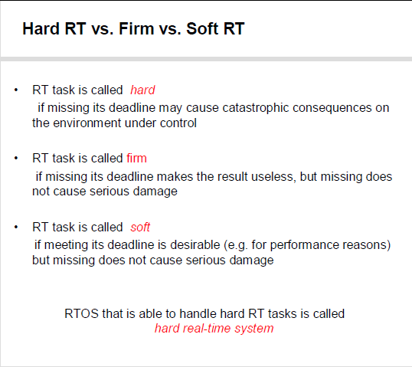

Slide 7
Realtime system
A Real-time system is required to complete its
work and deliver its services on a timely basis.
Examples of real-time systems include digital
control, command and control, signal processing, and telecommunication systems.

Slide 8
When we drive, they control the engine
and brakes of our car and regulate traffic lights.
When we fly, they schedule and monitor the
takeoff and landing of our plane, make it fly, maintain its flight path, and keep it out of harm’s
way.
When we are sick, they may monitor and regulate our blood pressure and heart beats.
When we are well, they can entertain us with electronic games and joy rides

Slide 9
DIGITAL CONTROL
Many real-time systems are embedded in sensors and actuators and function as digital controllers.
Figure below shows such a system. The term plant in the block diagram refers to a controlled system, for example, an engine, a brake, an aircraft, a patient. The state of the plant is monitored by sensors and can be changed by actuators. The real-time (computing) system estimates from the sensor readings the current state of the plant and computes a control output based on the difference between the current state and the desired state (called reference input in the figure). We call this computation the control-law computation of the controller. The output thus generated activates the actuators, which bring the plant closer to the desired state.

Slide 10
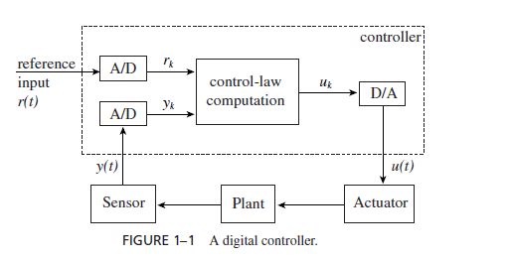
Digital Control
PID controller
A proportional-integral-derivative controller (PID controller) is a control loop feedback mechanism (controller) widely used in industrial control systems. A PID controller calculates an error value as the difference between a measured process variable and a desired setpoint.

Slide 11
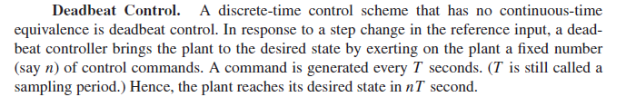
Kalman Filter. Kalman filtering is a commonly used means to improve the accuracy of measurements and to estimate model parameters in the presence of noise and uncertainty.

Slide 12
HIGH-LEVEL CONTROLS
Controllers in a complex monitor and control system are typically organized hierarchically.
One or more digital controllers at the lowest level directly control the physical plant. Each output of a higher-level controller is a reference input of one or more lower-level controllers.
With few exceptions, one or more of the higher-level controllers interfaces with the operator(s).

Slide 13
For example, a patient care system may consist of microprocessor-based controllers that monitor and control the patient’s blood pressure, respiration, glucose, and so forth. There may be a higher-level controller (e.g., an expert system) which interacts with the operator (a nurse or doctor) and chooses the desired values of these health indicators.
While the computation done by each digital controller is simple and nearly deterministic, the computation of a high level controller is likely to be far more complex and variable. While the period of a low level control-law computation ranges from milliseconds to seconds, the periods of high-level control-law computations may be minutes, even hours.

Slide 14
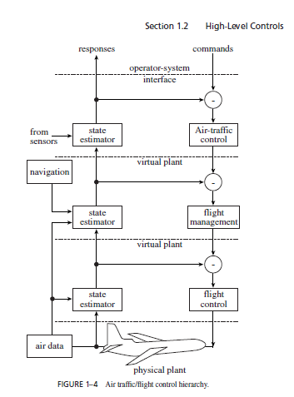

Slide 15
